Slide 1
Containers: The most basic “ADT”
COMP 251

Slide 2
Goals
Review ADTs.
Define the simplest ADT; namely, CONTAINERS.
Formally describe the operations on Containers.
Describe various types of Containers.
Show the logical connection between Containers and ADTs.
Some of this material is from Maryam Siahbani and some images are from “Algorithms and Data Structures” by Douglas Wilhelm Harder

Slide 3
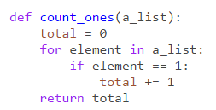
Preliminary Quiz
Define the Cartesian Product of two sets, A and B.
Define a Relation on two sets, A and B.
Define a Function on two sets, A and B.
Define a Graph based upon Graph Theory.
What is a Tree?
Calculate the time complexity of the following algorithm:

Slide 4
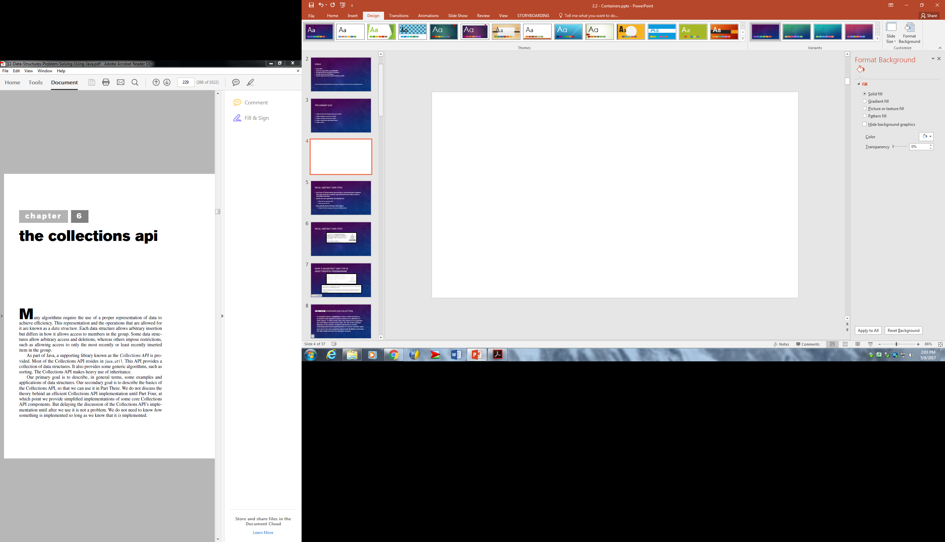

Slide 7
Recall Abstract data types
Any form of information processing or communication requires that data must be stored in and accessed from either main or secondary memory.
There are two questions we should ask:
What do we want to do?
How can we do it?
We will talk about Abstract Data Types:
Models of the storage and access of information.

Slide 8
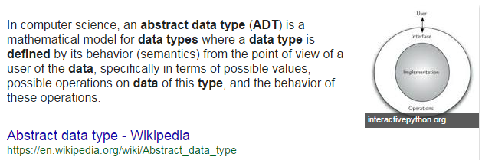
Recall Abstract data types

Slide 9

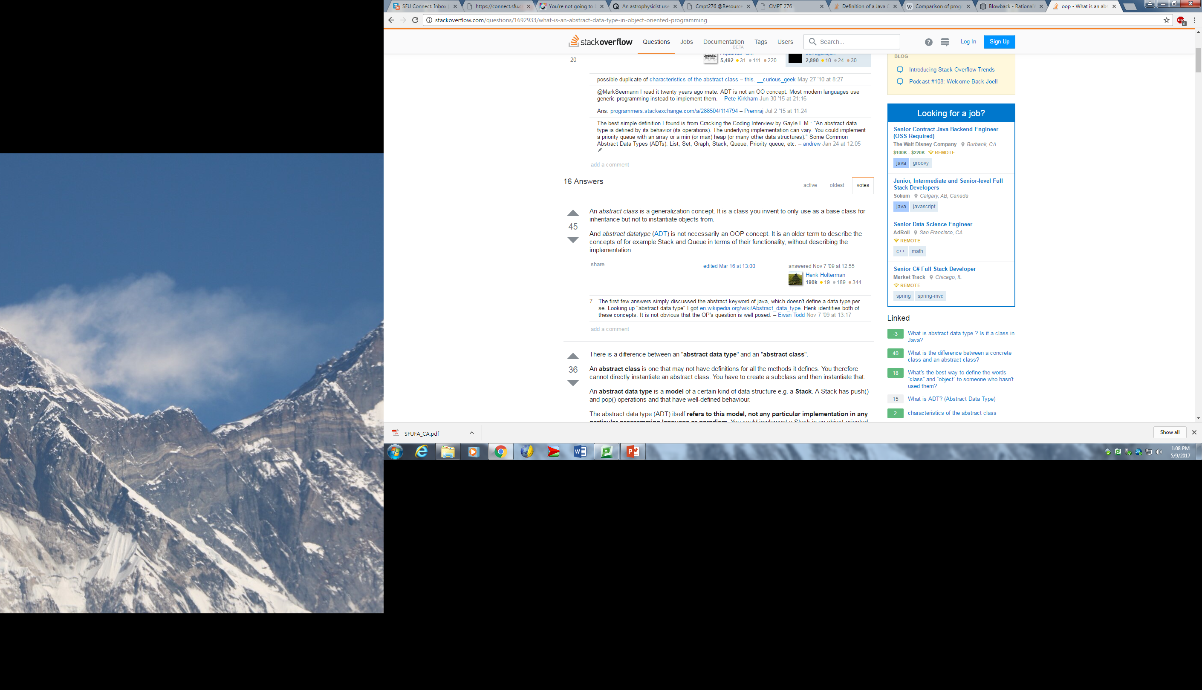
What is an abstract data type in object oriented programming?

Slide 10
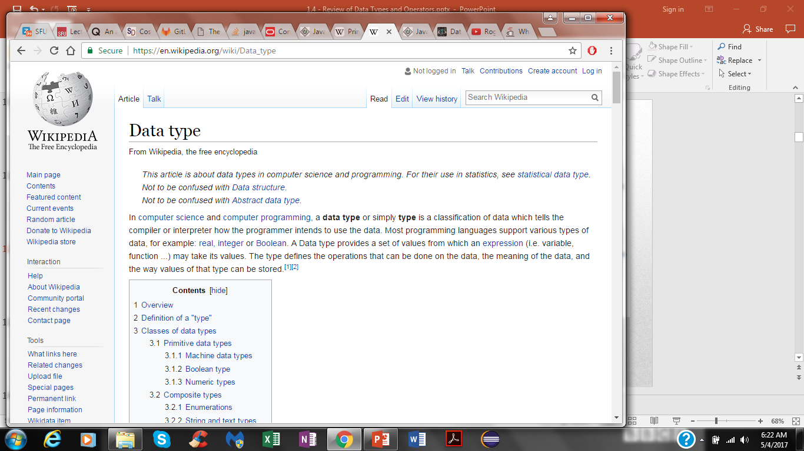
Definition: container (or collection)
In computer science, a container is a class, a data structure, or an abstract data type (ADT) whose instances are collections of other objects. In other words, they store objects in an organized way that follows specific access rules. The size of the container depends on the number of objects (elements) it contains. Underlying (inherited) implementations of various container types may vary in size and complexity, and provide flexibility in choosing the right implementation for any given scenario.

Slide 11
Operations
A container describes structures that store and give access to objects.
“A collection — sometimes called a container — is simply an object that
groups multiple elements into a single unit. Collections are used to store,
retrieve, manipulate, and communicate aggregate data. Typically, they
represent data items that form a natural group, such as a poker hand (a
collection of cards), a mail folder (a collection of letters), or a telephone
directory (a mapping of names to phone numbers).” from Java Collection Framework tutorial (http://docs.oracle.com/javase/tutorial/collections/intro/index.html)
The queries and operations of interest may be defined on:
• The container as an entity, or
• The objects stored within a container.

Slide 12
Operations
The operations we may wish to perform on a container are:
Create a new container
Copy or destroy an existing container
Empty a container
Query: “how many objects are in a container?”
Given two containers:
Find the union (merge), or
Find the intersection

Slide 13
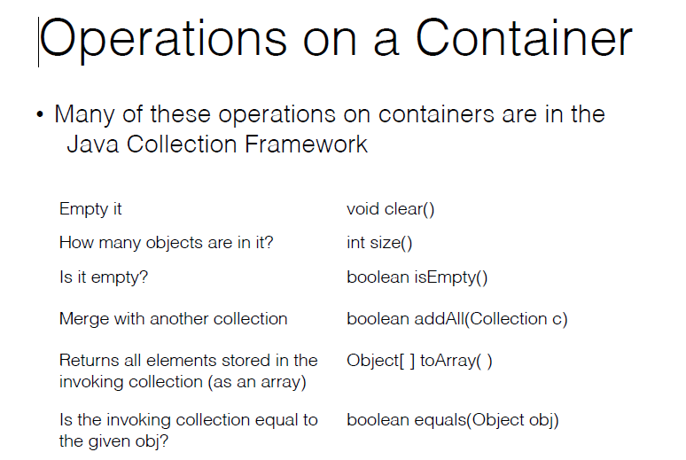

Slide 14
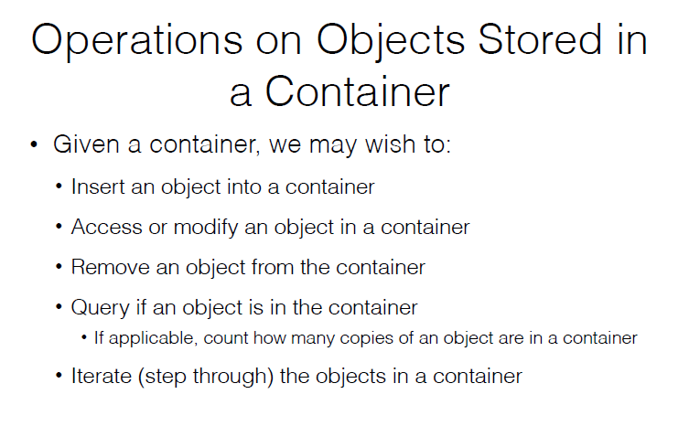

Slide 15
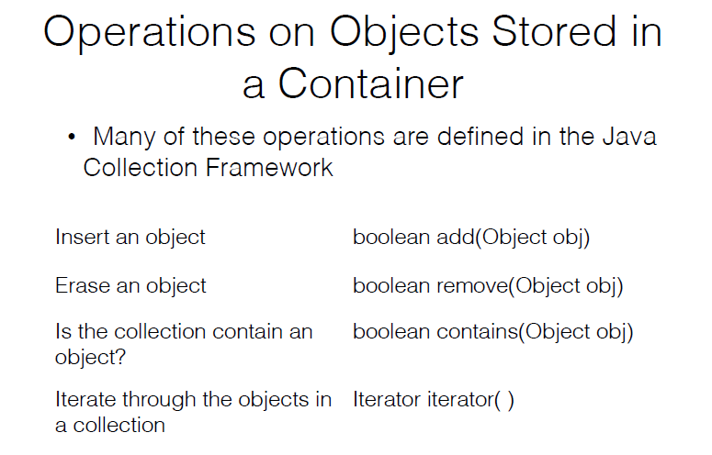

Slide 16
Single Value and Associative Containers
Containers can be divided into two groups.
Single value containers
Each object is stored independently in the container and it is accessed directly or with an iterator (i,.e., lists, stacks and queues).
Associative containers
An associative array, map, or dictionary is a container composed of (key, value) pairs, such that each key appears at most once in the container. The key is used to find the value, the object, if it is stored in the container (i,.e., map, hash map).
Any of the ADTs we will discuss can be implemented either way.

Slide 17
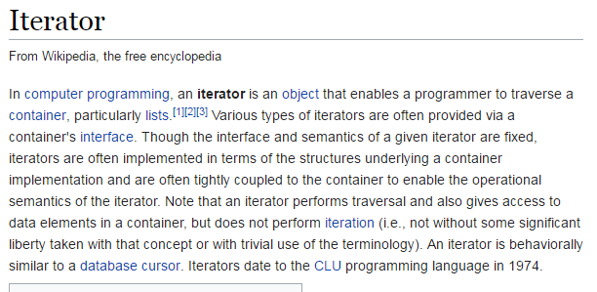
NOTE:

Slide 18
Subsets of operations
In any application, the actual required operations may be only a subset of the possible operations
In the design of any solution, it is important to consider both current and future requirements.
Under certain conditions, by reducing specific operations, the speed can be increased or the memory decreased.

Slide 19
Relations
However, we may want to store not only objects, but relationships between the objects.
Consequently, we may have additional operations based on the relationships.
Consider a genealogical database
We don’t only want to store the people, but we want to also make queries about the relationships between the people.

Slide 20
Relations
If we are not storing relationships, then there is a data structure that always operates at the same speed no matter how many objects are stored:
A hash table takes the same time to find an object whether there are 10 or one billion objects in the container.
It requires approximately 30 % more memory than is occupied by the objects being stored.

Slide 21
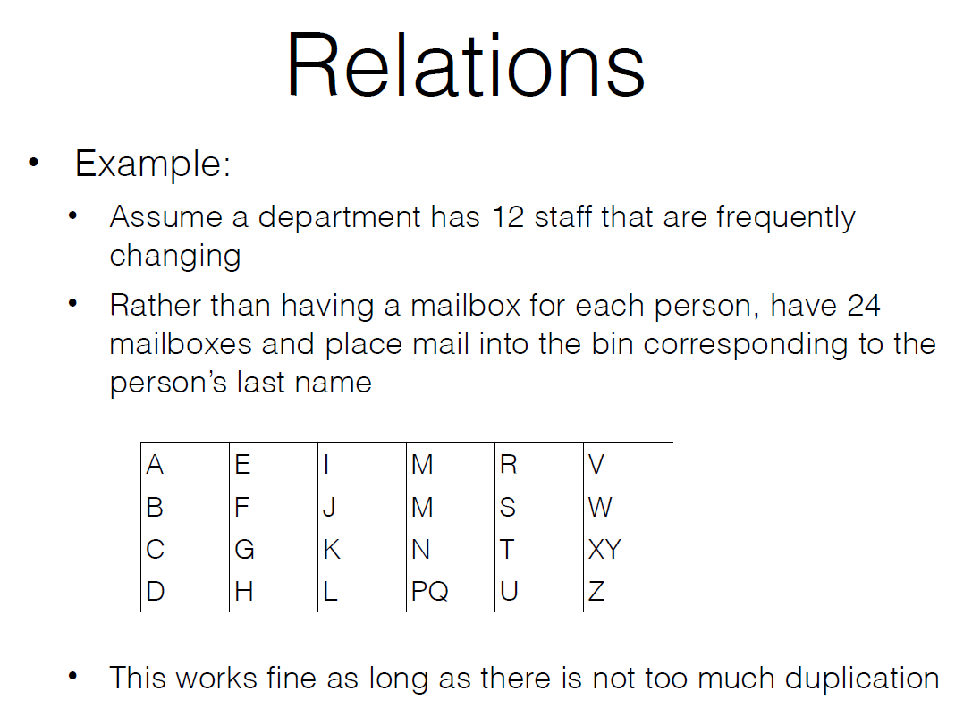

Slide 22
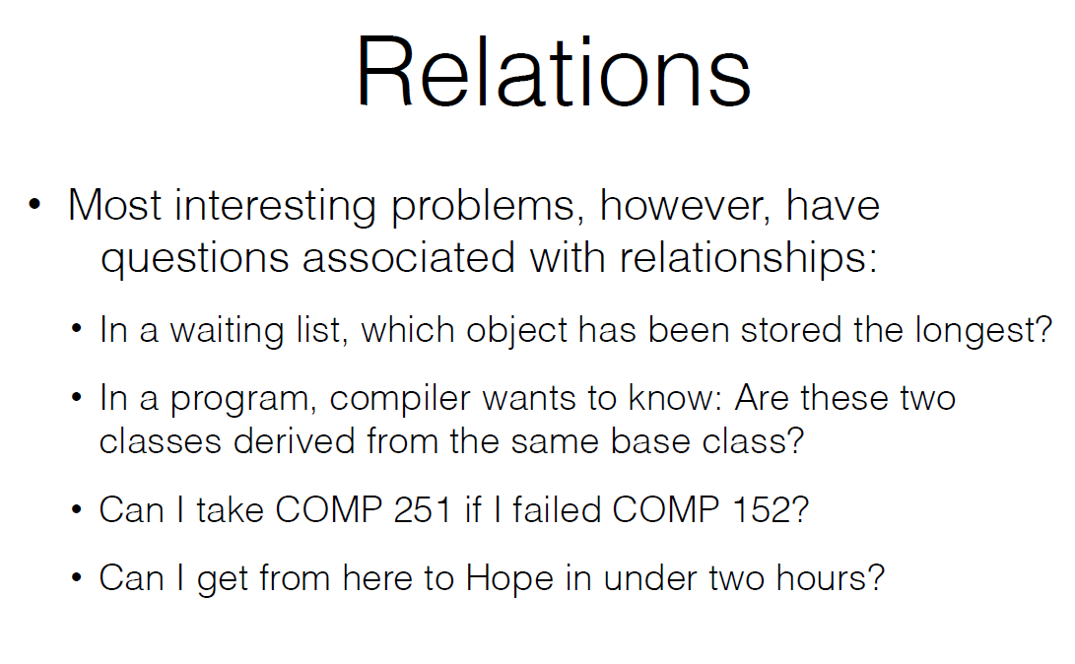

Slide 23
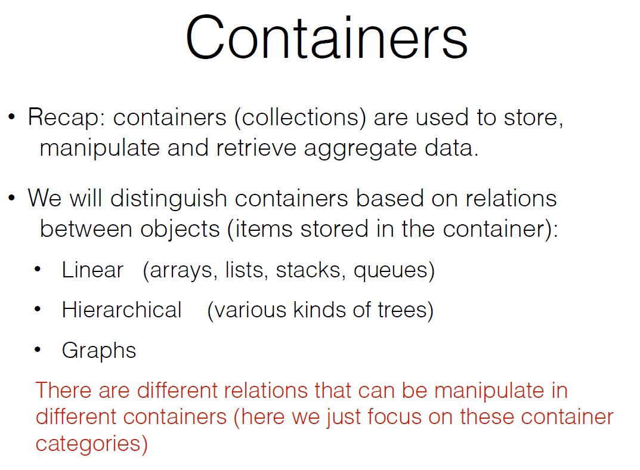

Slide 24
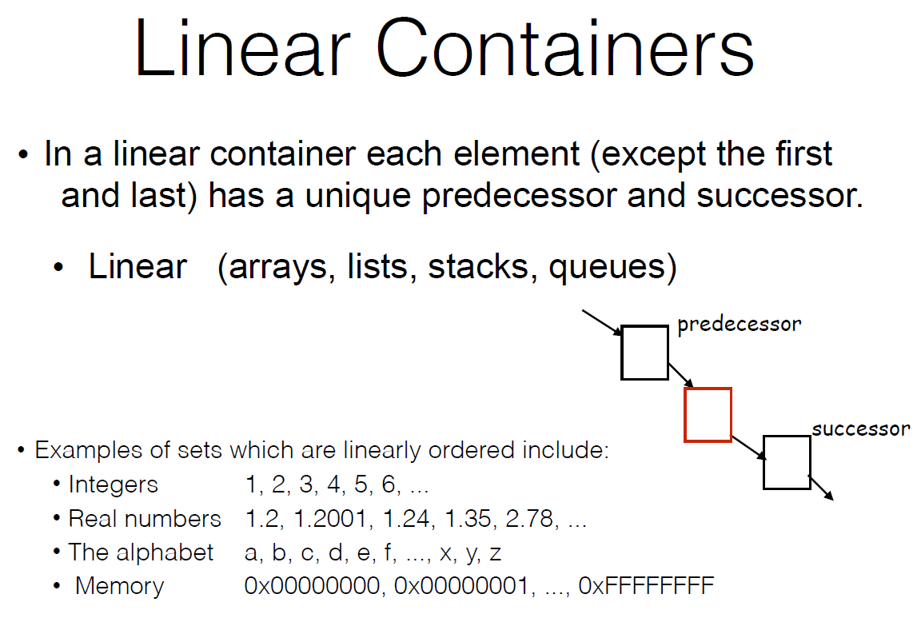

Slide 25
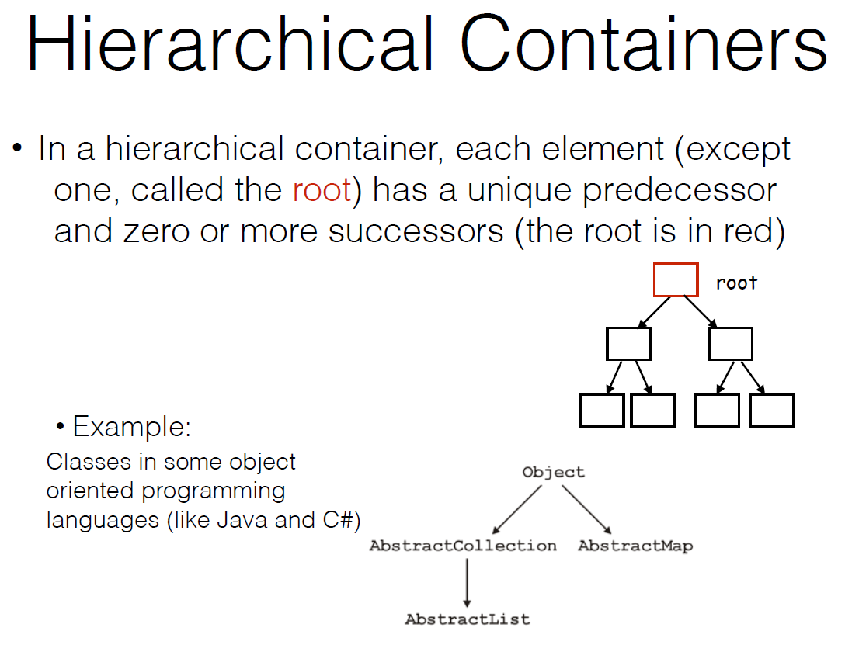

Slide 26
Definition: Graph
A graph G is an ordered pair of disjoint sets, (V, E) such that E is a subset of the set of unordered pairs of V.
NOTES:
Graphs are formal mathematical structures that model pair-wise relations among objects from a particular set.
G is a graph, then E = E(G) is the edge set of G and V = V(G) is the vertex set of G.
Clearly, E ⊆ V × V.
Edges connect pairs of vertices.

Slide 27
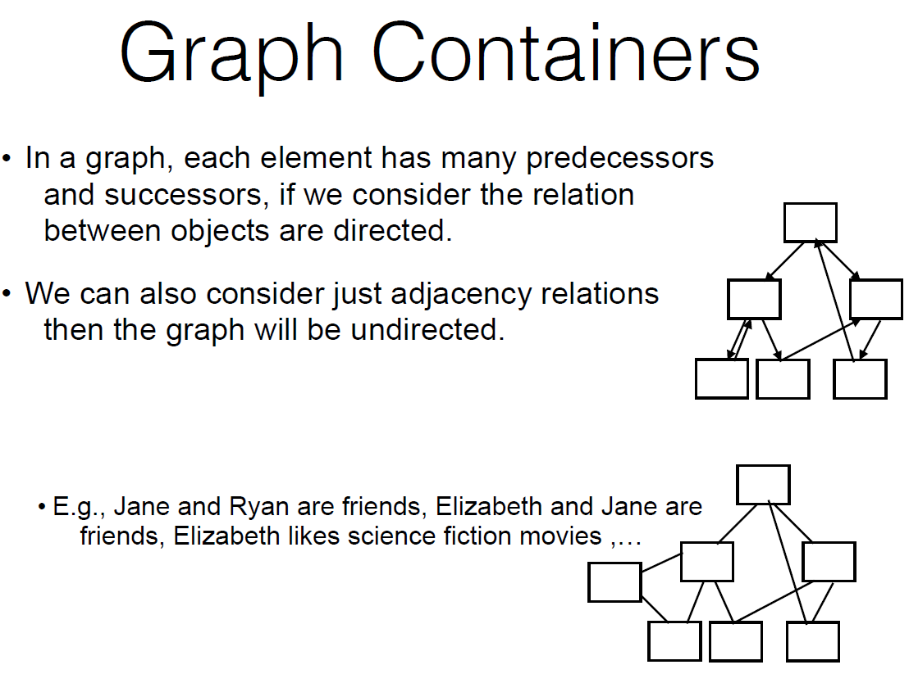

Slide 28
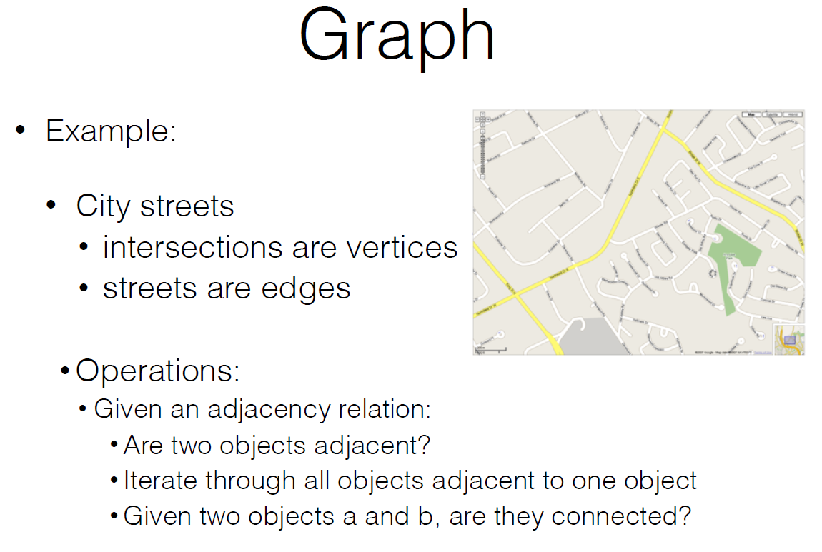

Slide 29
The Design of data structures based on relations
There are relationships on the objects we may wish to store, access, or query.
Given a problem, we should decide which data structure is suitable.
Most of the time we need to design a data structure based on the problem.
Any relationship may be either implicitly defined or explicitly imposed.

Slide 30
The Design of data structures based on relations
Again, any relationship may be either implicitly defined or explicitly imposed:
Integers are implicitly ordered based on their relative values.
Human groups are defined by the properties of the individuals .
A hierarchy in a company is explicitly defined.
The order of the letters on this slide are explicitly imposed by the author.

Slide 31
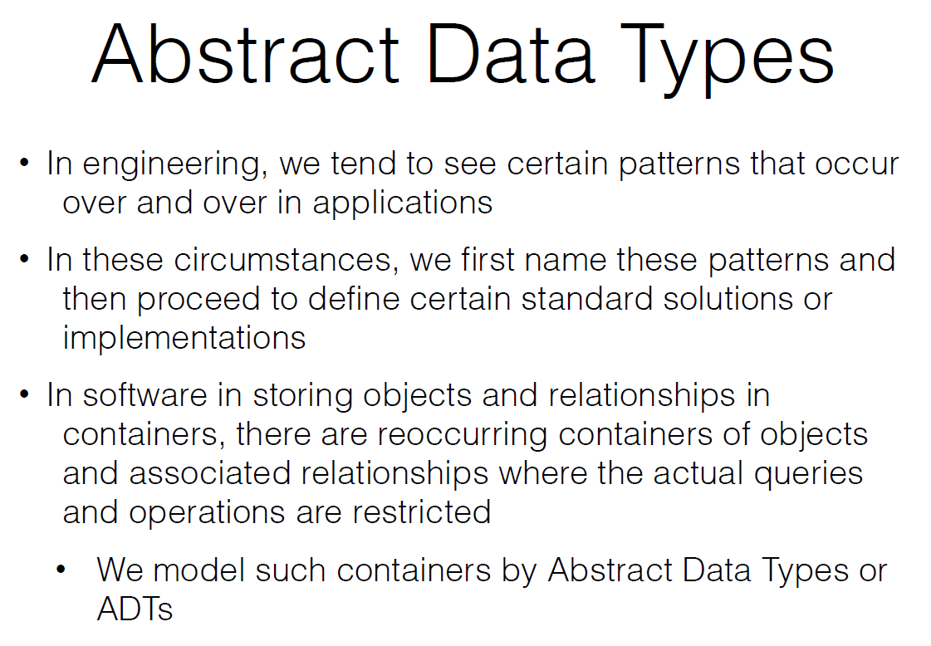

Slide 32
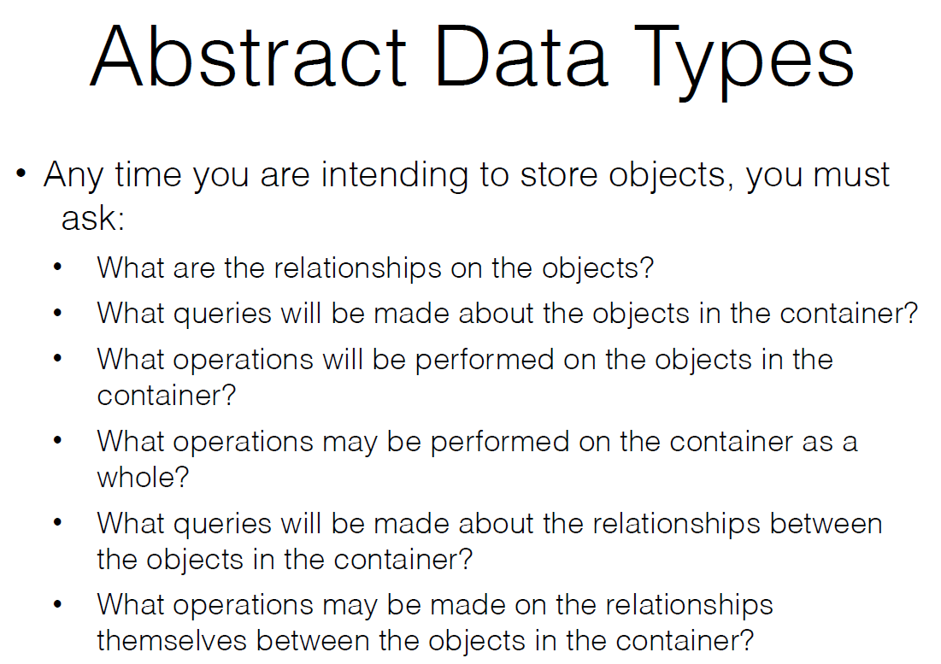

Slide 33
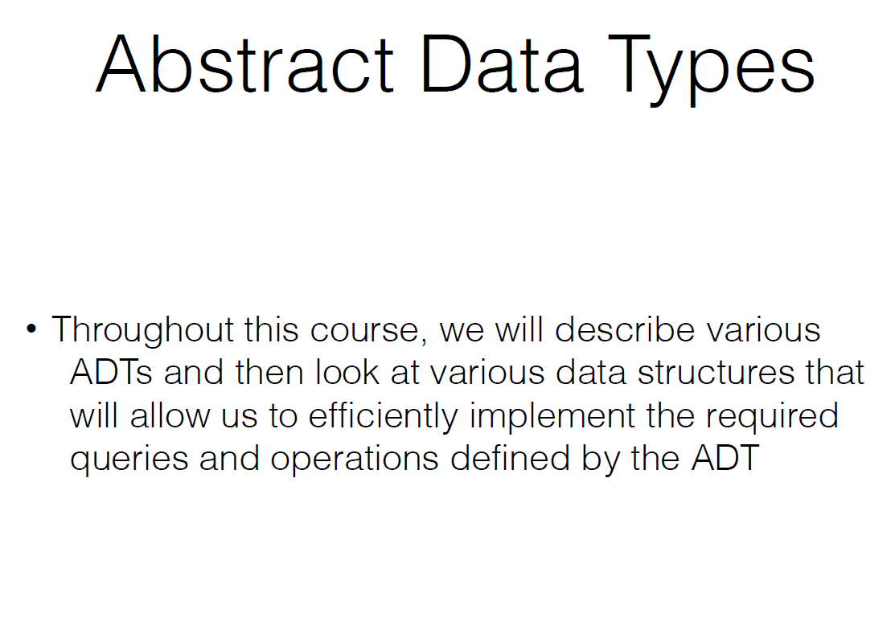

Slide 34
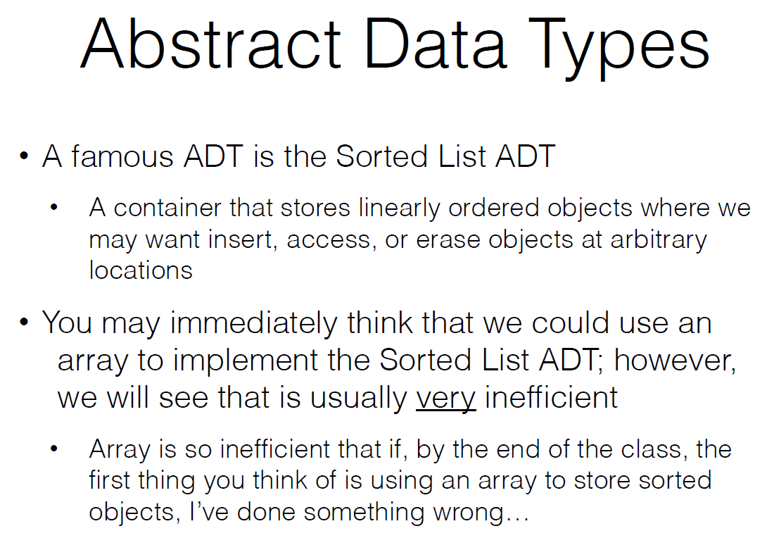

Slide 35
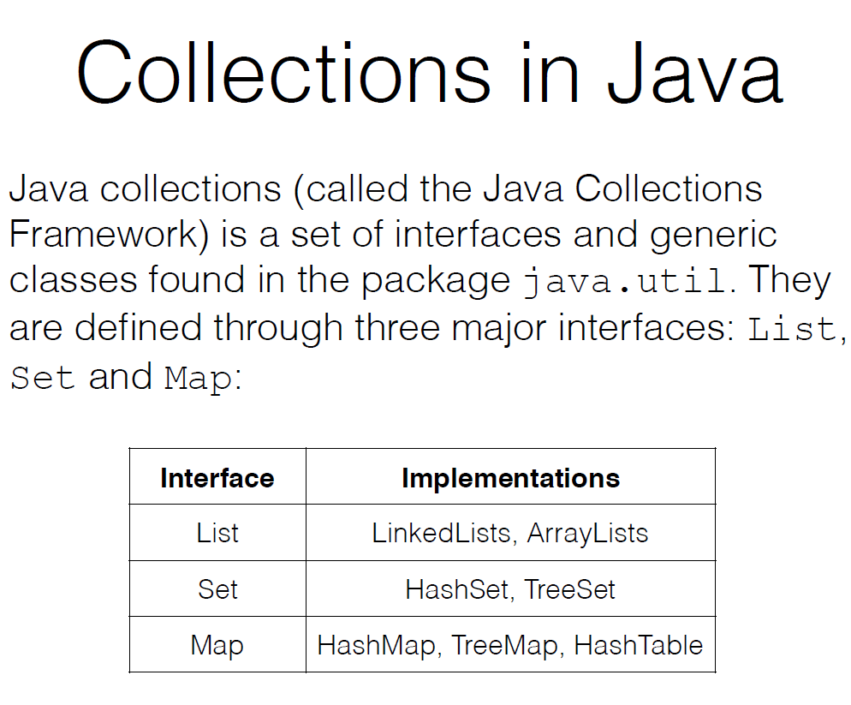

Slide 36
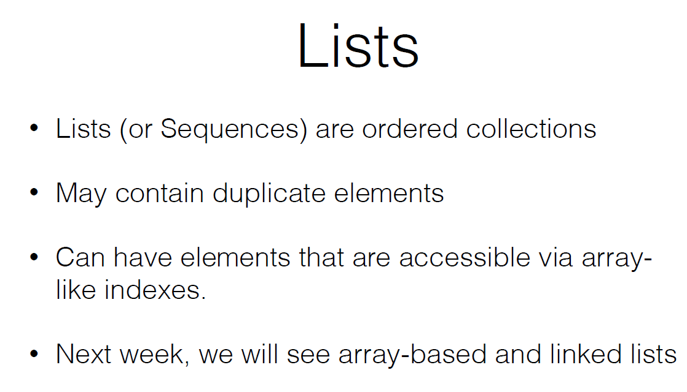

Slide 37
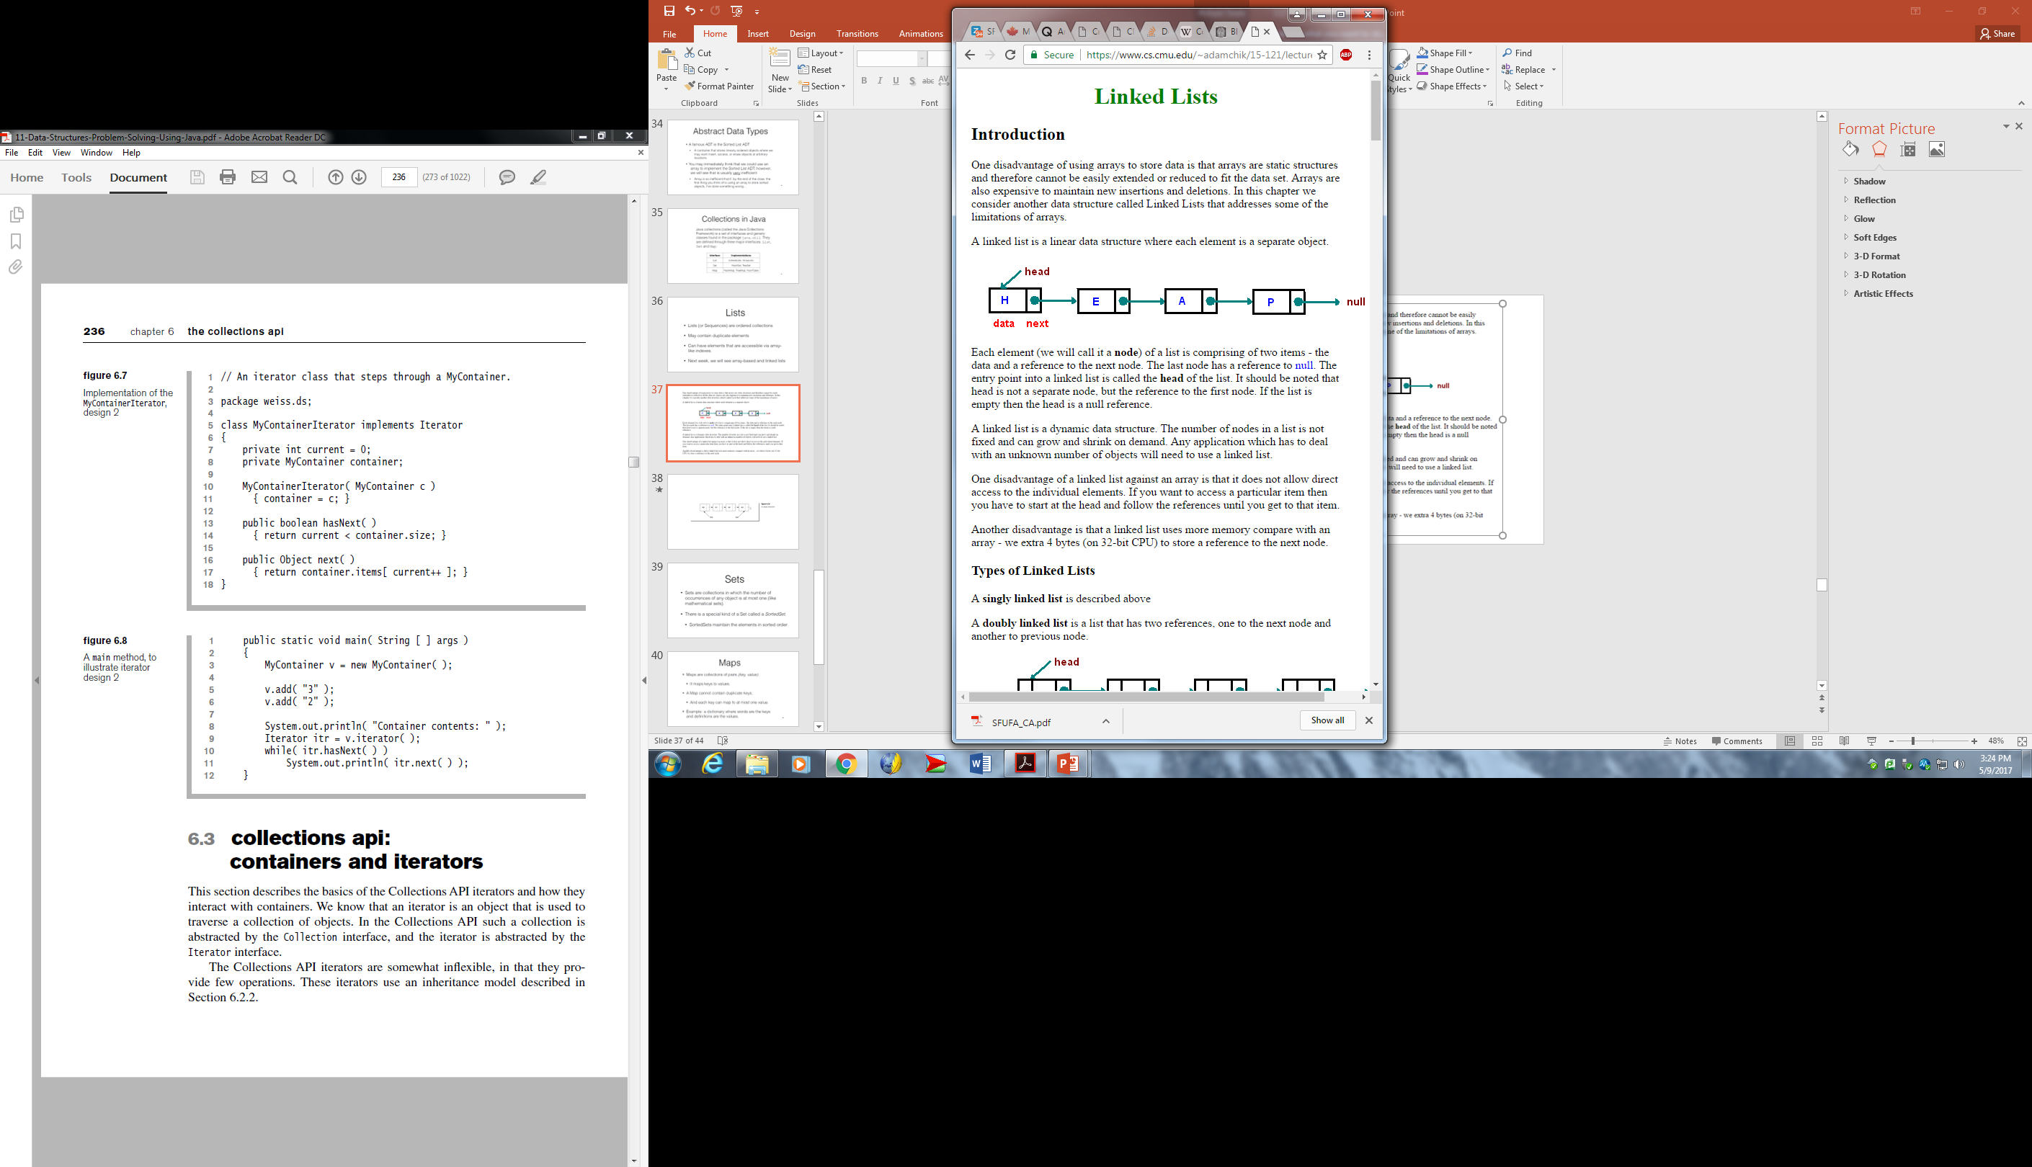

Slide 39
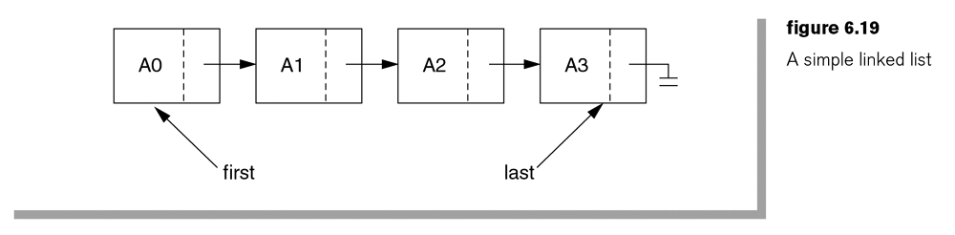

Slide 40
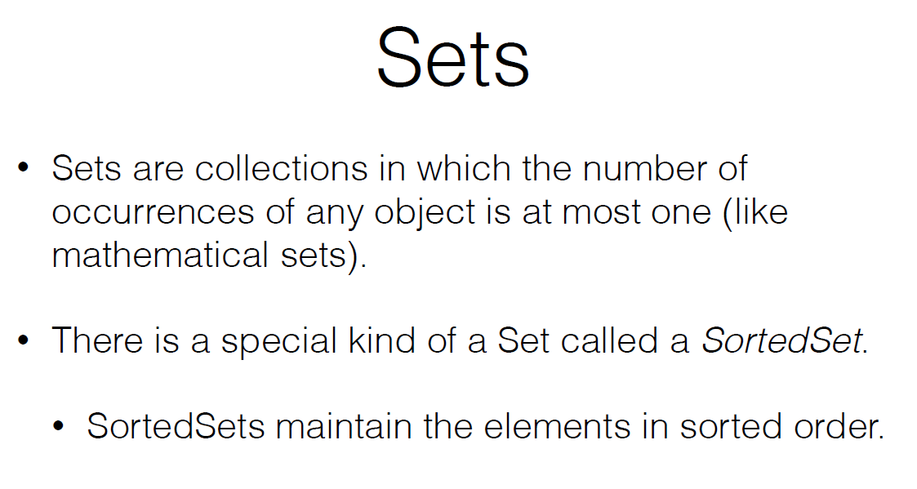

Slide 41
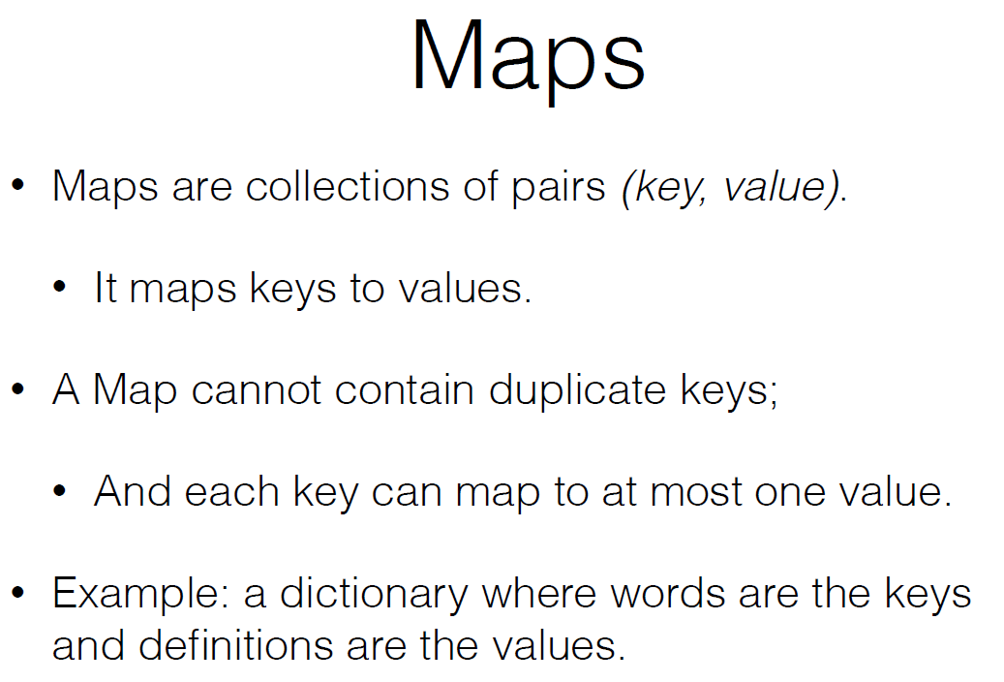

Slide 42
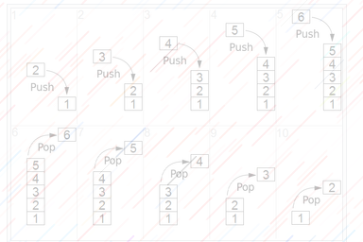
Stacks

Slide 43
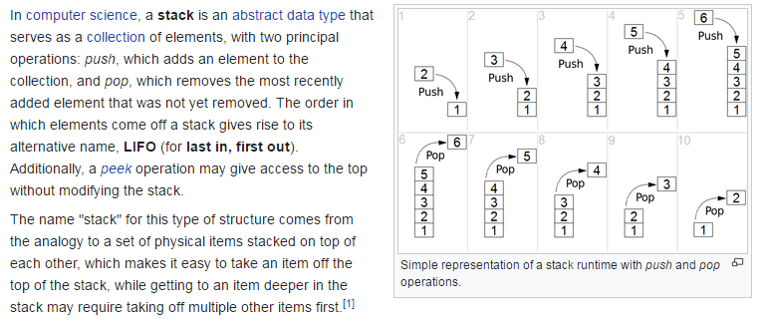

Slide 44
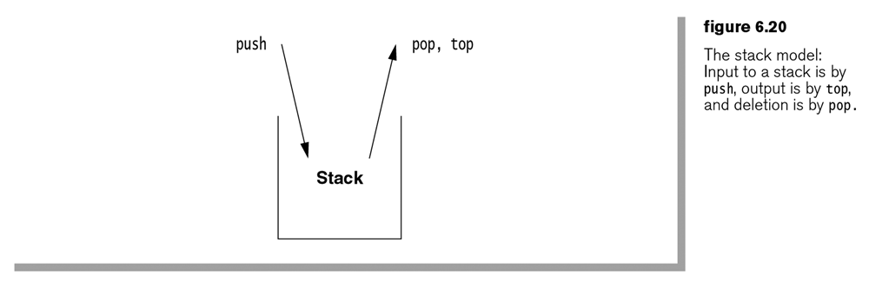

Slide 45
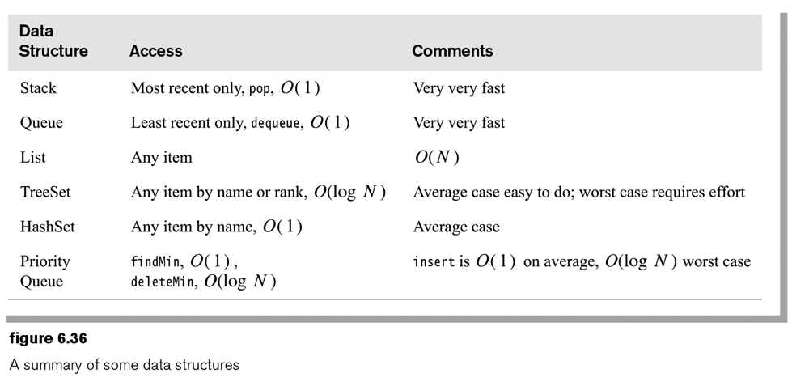

Slide 46
HOMEWORK
READ
Chapter 6.
Wikipedia:
https://en.wikipedia.org/wiki/Container_(abstract_data_type)
Eclipse:
https://www.eclipse.org/collections/

Slide 47
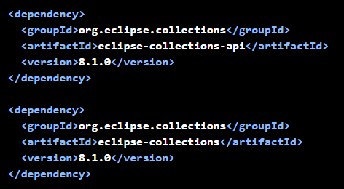
Presentation Terminated

